Slide 1
HOME CREDIT DEFAULT RISK
PREDICT HOW CAPABLE EACH APPLICANT IS OF REPAYING LOAN
Submitted by:
ANUR MODI – D19007
JOJU JOHN – D19011
KEDARKUMAR GOLLA – D19014
KRISHNAN HARIHARAN – D19015
VEERA VIGNESH – D19036
VIGHNESH TAMSE – D19037

Slide 2
OBJECTIVE
identify if a new client shows a high risk for loan default
DATASET
data is taken from Kaggle’s competitioN
https://www.kaggle.com/c/home-credit-default-risk/data
APPRAOCH
Supervised machine learning algorithm for classification
(LOGISTIC REGRESSION)

Slide 3
DATASET
application_train.csv
307511 Records, 122 Columns
Imbalanced Target Labels.
Source for training machine Learning models.
Target Labels :
0’s →282686
1’s → 24825
application_test.csv
48744 Records, 121 Columns
No Target Labels.
Source for testing the performance of machine Learning models.
Target Labels : None – need to predict.
TARGET LABELS
0 ➔ INDICATES THAT THERE WAS NO DIFFICULTY IN REPAYING THE LOAN ON TIME
1 ➔ INDICATES THAT THERE WAS DIFFICULTYIN REPAYING THE LOAN ON TIME

Slide 4
DATA CLEANING / IMPUTATION
VARIABLES IMPUTED WITH MEDIAN :
'AMT_REQ_CREDIT_BUREAU_HOUR’, 'AMT_REQ_CREDIT_BUREAU_DAY’, 'AMT_REQ_CREDIT_BUREAU_WEEK’, 'AMT_REQ_CREDIT_BUREAU_MON’, 'AMT_REQ_CREDIT_BUREAU_QRT’, 'AMT_REQ_CREDIT_BUREAU_YEAR’
'OBS_30_CNT_SOCIAL_CIRCLE’, 'DEF_30_CNT_SOCIAL_CIRCLE’\, 'OBS_60_CNT_SOCIAL_CIRCLE’, 'DEF_60_CNT_SOCIAL_CIRCLE’, ‘AMT_ANNUITY’
VARIABLES IMPUTED WITH MODE :
‘NAME_TYPE_SUITE’ (CATEGORICAL VARIABLE)
VARIABLES IMPUTED WITH ZERO :
ALL THE COLUMNS WITH HOUSING INFORMATION
VARIABLES DROPPED :
‘WALLSMATERIAL_MODE’, ‘HOUSETYPE_MODE’, ‘FONDKAPREMONT_MODE’, ‘EXT_SOURCE_1’, ‘OCCUPATION_TYPE’, ‘EMERGENCYSTATE_MODE’

Slide 5
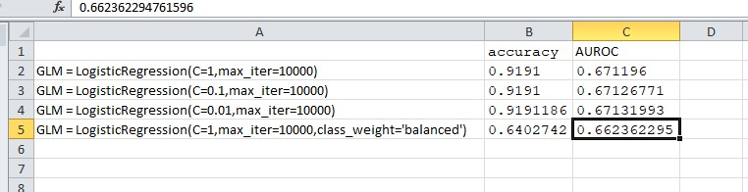
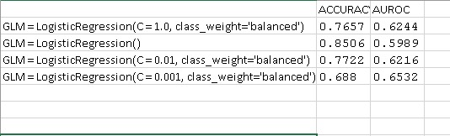
MODEL EXPERIMENT RESULTS
BASE MODEL
(L2 REGULARIZATION)
MODEL AFTER FEATURE SELECTION

Slide 6
FEATURE SELECTION
SELECTION BY CALCULATING WEIGHT OF EVIDENCE AND INFORMATION VALUE
TRAIN-TEST SPLIT : STRATIFIED SAMPLED (75-25)
FEATURES SELECTED:
0.3 < IV < 0.5 → STRONG PREDICTORS (2) ‘EXT_SOURCE_3’,
‘EXT_SOURCE_2’
0.1 < IV < 0.3 → MEDIUM PREDICTORS (13) 'PREV_APPL_MEAN_CARD_MEAN_CNT_DRAWINGS_CURRENT’,
'PREV_APPL_MEAN_CARD_MEAN_CNT_DRAWINGS_ATM_CURRENT’,
'PREV_APPL_MEAN_CARD_MEAN_AMT_DRAWINGS_CURRENT’,
'PREV_APPL_MEAN_CARD_MEAN_AMT_BALANCE’,
'PREV_APPL_MEAN_CARD_MEAN_AMT_RECEIVABLE_PRINCIPAL’,
'PREV_APPL_MEAN_CARD_MEAN_AMT_RECIVABLE’,
'PREV_APPL_MEAN_CARD_MEAN_AMT_TOTAL_RECEIVABLE’,
'PREV_APPL_MEAN_CARD_MEAN_AMT_DRAWINGS_ATM_CURRENT’,
'PREV_BUR_MEAN_DAYS_CREDIT’,
'PREV_APPL_MEAN_CARD_MEAN_AMT_INST_MIN_REGULARITY’,
'PREV_APPL_MEAN_CARD_MEAN_CNT_INSTALMENT_MATURE_CUM’,
'PREV_APPL_MEAN_CARD_MEAN_CNT_DRAWINGS_POS_CURRENT’,
'DAYS_EMPLOYED’
ACCURACY OF THE MODEL : 68 %
AUROC : 68.33 %

Slide 7
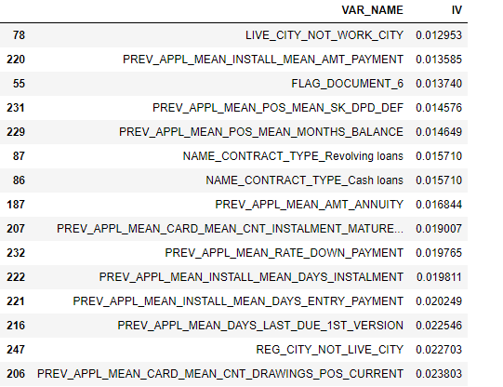
FEATURE SELECTION
SELECTION BY CALCULATING L1 REGULARIZATION
TRAIN-TEST SPLIT : STRATIFIED SAMPLED (75-25)
FEATURES SELECTED: TOP 50
STRONG PREDICTORS : ‘EXT_SOURCE_3’,
‘EXT_SOURCE_2
ACCURACY OF THE MODEL : 68.59 %
AUROC : 73.63 %
AKAIKE INFORMATION CRITERIA (AIC) :

Slide 8
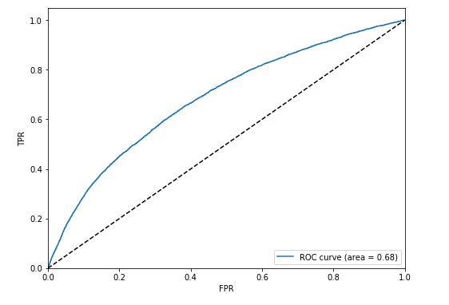
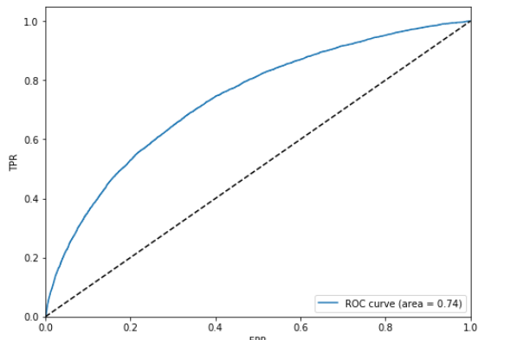
Model validation
MODEL WITH L1 REGULARIZATION
AUC : 0.74
KAGGLE TEST SCORE : 0.7004
MODEL SELECTED WITH IV AND WOE
AUC : 0.68

Slide 9
CONCORDANCE AND DISCORDANCE
CONCORDANCE : 73.63 %
DISCORDANCE : 26.37 %
GOODMAN KRUSKAL GAMMA:
0.527
SOMER’s D : 0.473
 | precision | recall | f1-score | support
0 | 0.95 | 0.76 | 0.85 | 70672
1 | 0.18 | 0.58 | 0.27 | 6206

Slide 10
THANK YOU

